Slide 1


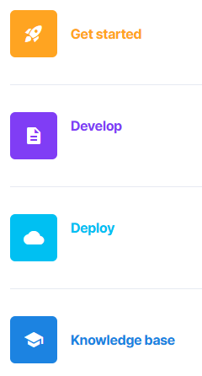
Advanced Data Analytics
Instructor: Chris Santo
Using Streamlit and Python for Advanced Data Analytics
Wednesday 6/3/2026

Slide 2

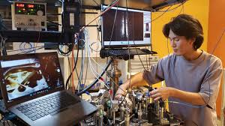
Warning: Experimental
I've never run these labs in a classroom. This is an experiment, so our results may vary. Please be kind on my surveys ☺

Slide 3

Streamlit – Multipage App Lab
Now we will create a multipage app in Streamlit.
Goals:
Create a multipage app in Streamlit using code cloned from a github repo Learn about more visualizations

Slide 4
Streamlit – Multipage App Lab
Streamlit allows you to create a multipage application with default navigation. Each page has its own python script. For this assignment, you'll make a copy of my git repository in your own github, then you'll work from there.
> Login to github.com, navigate to repositories and click the green "New" button. > Click the "import a repository" link near the top/middle of screen
(Instructor to Demo)

Slide 5
Streamlit – Multipage App Lab
Next steps . . .
> Paste in the follow URL for your source repository: https://github.com/csanto931/NITIC_streamlit
> Leave username and access token fields blank
> In "repository name" type in Streamlit-Multipage > Public access is OK > Click green "Begin Import" button
> And we wait and watch a big circle spinning
(Instructor to Demo)

Slide 6
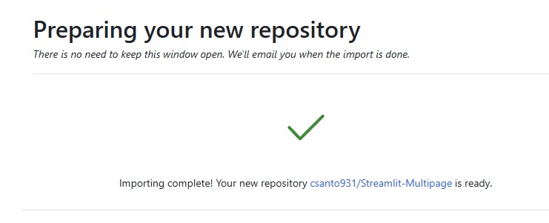
Streamlit – Multipage App Lab
Hopefully we are here:

Slide 7
Streamlit – Multipage App Lab
Next steps . . .
> Now we publish your version of the multipage app to the community cloud. > Navigate to https://share.streamlit.io and login like last time.
> Click "Create App" at top/right of screen. > Select "Deploy a public app from Github" > Pick the repository we just copied from dropdown > Branch = main should be OK > Main file path = select the hello.py
> Note the app URL. Don't change it. Click Deploy. (Instructor to demo)

Slide 8
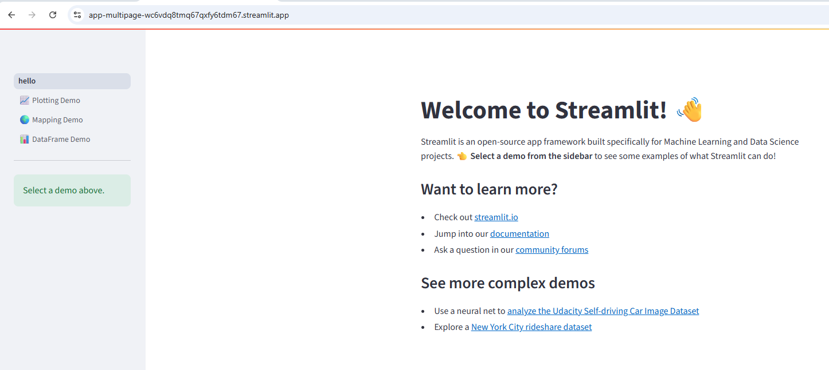
Streamlit – Multipage App Lab
Success

Slide 9
Streamlit – Multipage App Lab
Instructor to walkthrough code of the multipage app.
(Instructor to demo)

Slide 10

Streamlit – Multipage App Lab
Reflections – Comments – Questions?

Slide 11

End

